Slide 1
Rank Minimization with Applications to Image Noise Removal
Huang Yumei
School of Mathematics and Statisctics
Lanzhou University

Slide 2
Outline
Introduction
  Matrix Low Rank Minimization Problem
  Matrix Completion Problem
Proposed Method for Rank Minimization Problem
  The Proposed Low Rank Minimization Model
  Hard Shrinkage Method
Rank Minimization Method For Image Noises Removal
Numerical Results

Slide 3
Matrix Low Rank Minimization Problem

Slide 4


Matrix Low Rank Minimization Problem
Rank minimization problem is generally formulated as:
: a convex set.
This is a NP-hard and non-convex problem.
Applications: controller design, system identification, computer vision and machine learning.

Slide 5
Algorithms for some special rank minimization problems
W. Ledermann, On a problem concerning matrices with variable diagonal elements, Proceedings of the Royal Society of Edinburgh, vol. 60, pp. 1-17, 1940.
M. Mesbahi and G. P. Papavassilopoulos, On the rank minimization problem over a positive semidefinite linear matrix inequality, IEEE Trans. Automat. Control, vol. 42, pp. 239-243, 1997.
Y. Nesterov and A. Nemirovskii, Interior-Point Polynomial Algorithms in Convex Programming, SIAM, Philadelphia, 1994.
P. A. Parrilo and S. Khatri, On cone-invariant linear matrix inequalities, IEEE Trans. Automat. Contr., vol. 45, pp. 1558-1563, 2000.

Slide 6
Nuclear Norm Minimization
Fazel et al. generalized the trace heuristic to general matrices and proposed nuclear norm.
M. Fazel, H. Hindi and S. P. Boyd, A rank minimization heuristic with application to minimum order system approximation, American Control Conference, 2001, Proceedings of the 2001, vol. 6, IEEE, 2001, pp. 4734-4739.

Slide 7

Nuclear norm is the sum of all singular values of a matrix and it is proved that the nuclear norm is the convex envelope of the matrix’s rank on the set of matrices with norm less than one.
Nuclear norm minimization can be reduced to SDP problems and the efficient SDP solvers such as SDPT3 or SeDuMi which are based on the interior point method are often used to solve them.

Slide 8
References
S. Ma, D. Goldfarb and L. Chen, Fixed point and bregman iterative methods for matrix rank minimization, Math. Program. A, vol. 128, no. 1, pp. 321-353, 2011.
K. C. Toh and S. Yun, An accelerated proximal gradient algorithm for nuclear norm regularized least squares problems, Pac. J. Optim.,vol. 6, no. 3, pp. 615-640, 2010.

Slide 9
Matrix Completion Problem

Slide 10



Matrix Completion Problem
：a random subset of cardinality m
: is the observed matrix but only m sampled entries in are available and the others are missing.

Slide 11
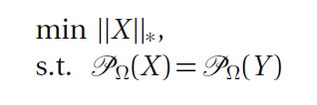
Nuclear norm minimization is solved instead
Methods to solve it
the Bregman iterative algorithms
the accelerated proximal gradient algorithm
SDPT3

Slide 12

When the incomplete observed data Y is noisy, the equality constraint is too strict. By using the Frobenius norm to measure the fidelity term, the following relaxed form is often considered for noisy observation completion.

Slide 13




Specifically, Cai et. al considered
The solution is:
J.-F. Cai, E. J. Candès and Z. Shen, A singular value thresholding algorithm for matrix completion, SIAM J. Optim., vol. 20, no. 4, pp.1956-1982, 2010.

Slide 14
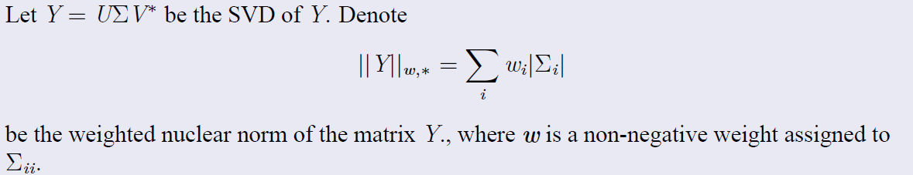
Weighted Nuclear Norm Minimization Problem
S. Gu, L. Zhang,W. Zuo, X. Feng, Weighted nuclear normminimization with application to image denoising, in: Proceedings of 2014 IEEEConference on Computer Vision and Pattern Recognition, 2014, pp. 2862-2867

Slide 15
Proposed Method for Low Rank Minimization Problem

Slide 16
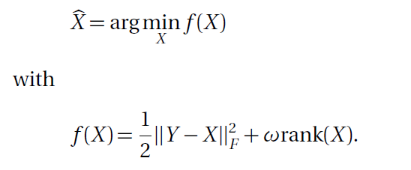
Proposed Method for Low Rank Minimization Problem

Slide 17
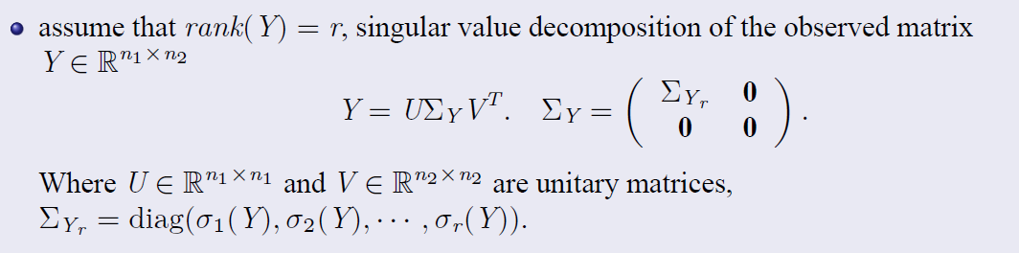
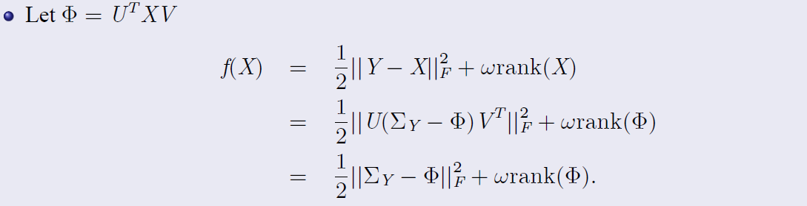

Slide 18
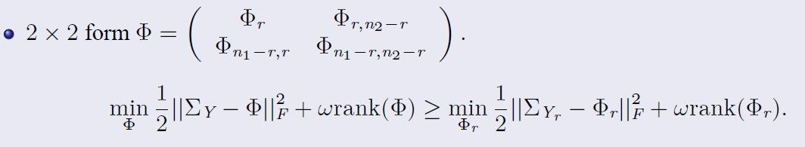
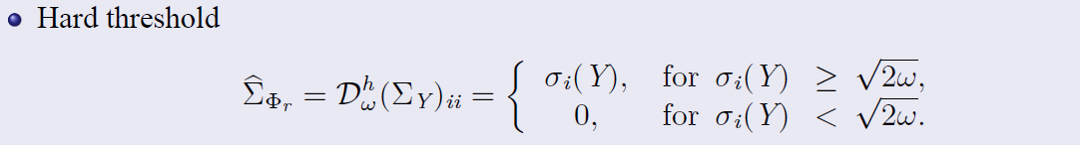

Slide 19




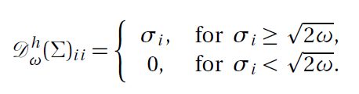

Slide 20
Rank Minimization Method For Image Noise Removal

Slide 21
References of Low Rank Method for Noises Removal
H. Ji, C. Liu, Z. Shen and Y. Xu, Robust video denoising using low-rank matrix completion, In CVPR, pp. 1791-1798, 2010.
S. Gu, L. Zhang, W. Zuo and X. Feng, Weighted nuclear norm minimization with application to image denoising, in Proc. IEEE Conf. Comput. Vis. Pattern Recognit., pp. 2862-2867, 2014.

Slide 22

Rank Minimization Method For Image Noises Removal

Slide 23


The proposed method is applied to solve the following cost function

Slide 24

Iterative Regularization
S. Osher, M. Burger, D. Goldfarb, J. Xu, W. Yin, An iterative regularization method for total variation-based image restoration, Multiscale，Model. Sim. 4 (2) (2005) 460-489.

Slide 25
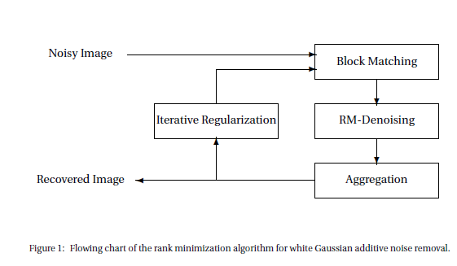

Slide 26



Parameter Setting
S. Grace Chang, Adaptive Wavelet Thresholding for Image Denoising and Compression, IEEE TRANSACTIONS ON IMAGE PROCESSING, VOL. 9, NO. 9, SEPTEMBER 2000.

Slide 27
Numerical results

Slide 28
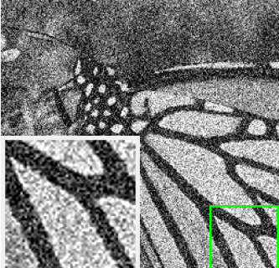
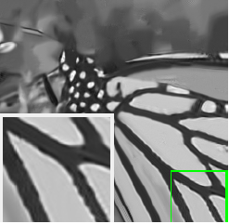
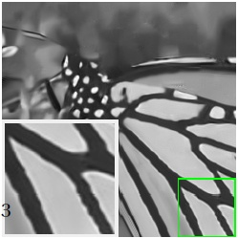
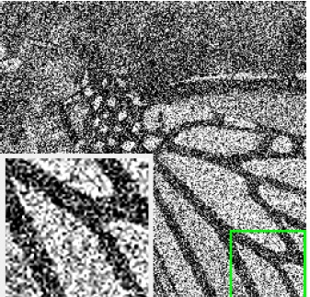
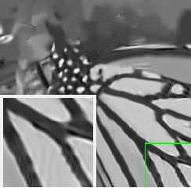
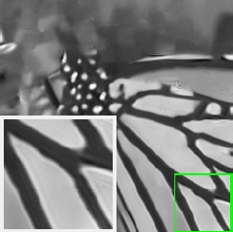
Gaussian White Noise
Variance:50
WNNM (26.32)
Proposed(26.32)
Variance:100
WNNM (22.95)
Proposed(22.99)

Slide 29
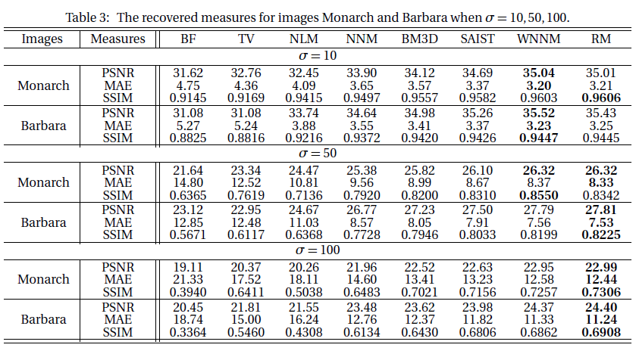

Slide 30
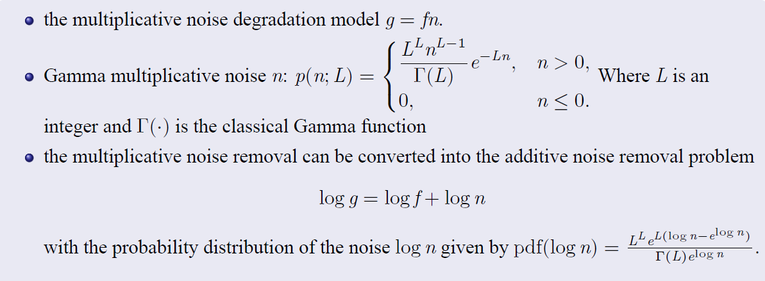
Multiplicative Gamma Noise

Slide 31
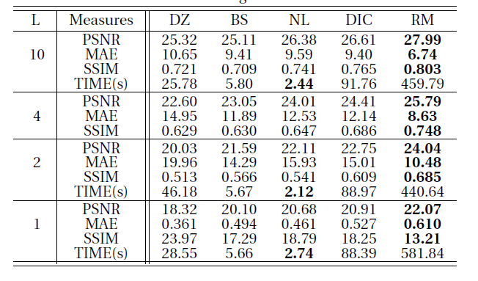
Recovered Measures for Different L

Slide 32
Thanks!

